Slide 1


Slide 2
“COMMUNION ACCESSIBILITY”
A
N
N
O
U
N
C
E
M
E
N
T
We try to accommodate
everyone who worships with us at Immanuel.
If for any reason
you are unable to commune at the altar,
please inform an usher,
and we will bring communion to you in your pew.

Slide 3

“HEARING ASSIST DEVICES”
A
N
N
O
U
N
C
E
M
E
N
T

Slide 4
B
I
B
L
E
S
T
U
D
Y
“FOLLOW”
Jesus only issues an invitation to relationship
that begins with a simple request: “Follow Me”.
SMP Pastor Al Kersten leads this DVD/workbook
based study, by Andy Stanley, as we journey
to follow Jesus through the Gospels.
The class begins Sunday mornings at 9:15
in the adult education room.

Slide 5
B
I
B
L
E
S
T
U
D
Y
“ROOTED IN THE PREEMINENT CHRIST”
This study which is led by Pastor Erickson meets at 9:15 a.m.
in the church library – lounge.
St. Paul’s letter to the Colossians is used to guide the study and discussion.

Slide 6
B
I
B
L
E
S
T
U
D
Y
“BEING LUTHERAN”
A Youth / Adult Bible Class meets Sunday mornings at 9:15 A.M.
in the fellowship room.
This study is led by Pastor Schultz.
The class uses the book
written by Pastor Trevor Sutton of Haslett, MI.,
entitled “Being Lutheran”.

Slide 7
B
I
B
L
E
S
T
U
D
Y
“EARLY BIRD BIBLE STUDY”
This study meets Monday mornings
at 7:00 A.M. in the lighthouse room
of the Thunder Bay River Restaurant.
Pastor Erickson leads
this current study
in the book of 1 Kings.

Slide 8
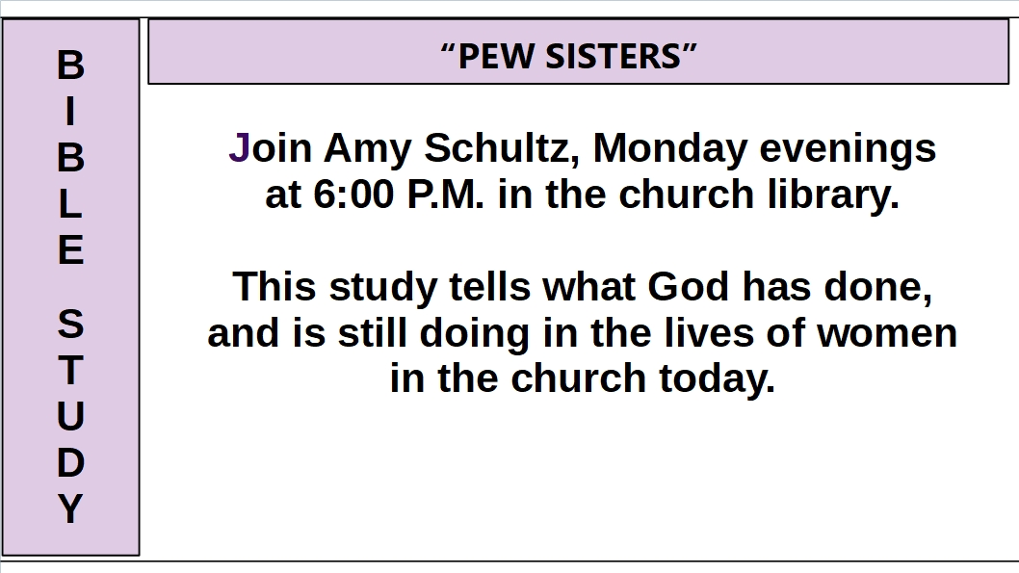

Slide 9
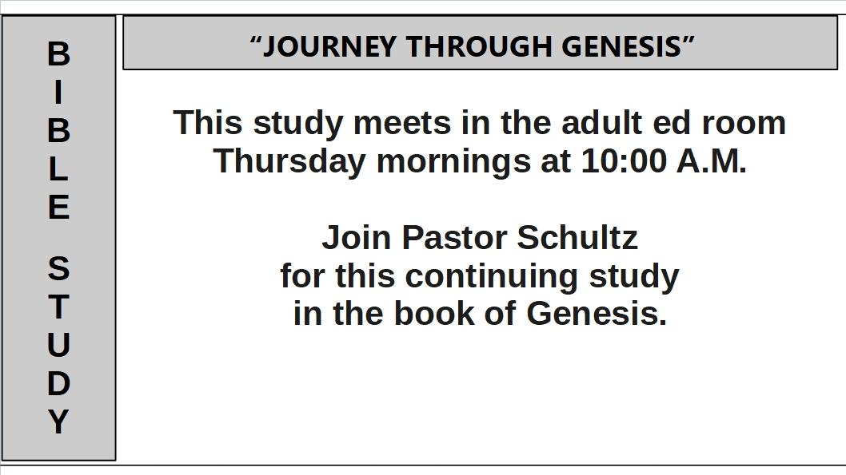

Slide 10


Slide 11
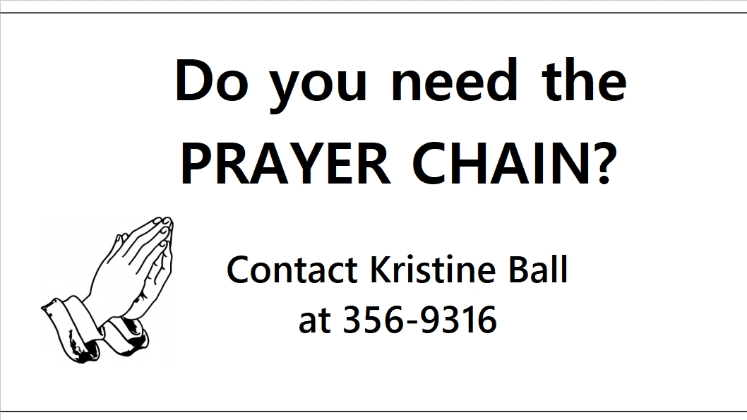
“PRAYER CHAIN INFO”
A
N
N
O
U
N
C
E
M
E
N
T

Slide 12

“VISITATION EVANGELISM”
A
N
N
O
U
N
C
E
M
E
N
T

Slide 13
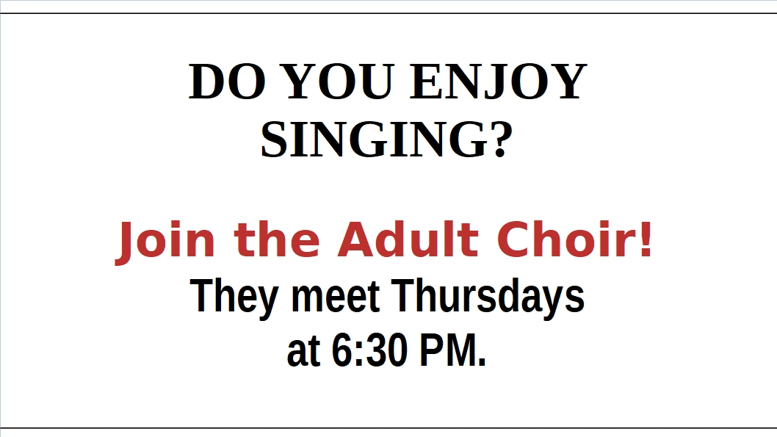
“ADULT CHOIR NEEDS YOU!”
A
N
N
O
U
N
C
E
M
E
N
T
.

Slide 14


Menu:
Pancakes and breakfast meats,
coffee, juice and milk.
Feel free to bring an egg dish to pass and a free will donation
to support the 7th & 8th grade class trip to Grand Rapids.
Join us to celebrate that He is RISEN!
EASTER BREAKFAST
Sunday, April 21st, 2019
8:30 am to 10:30 am

Slide 15
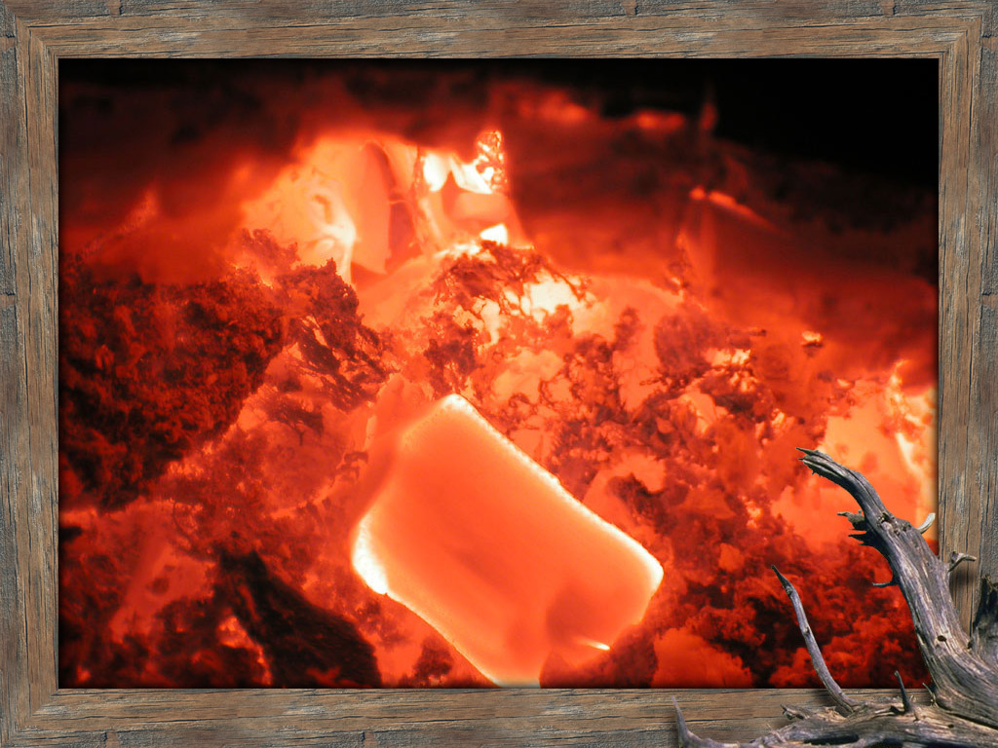
“YOUTH GROUP MEETING”
A
N
N
O
U
N
C
E
M
E
N
T
YOUTH GROUP
THURSDAYS at 6:30 p.m.
For grades 7-12
and college-age.

Slide 16
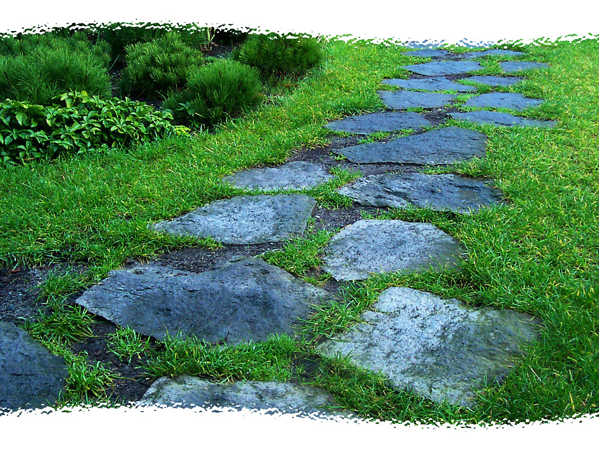
“RESURRECTION EGG HUNT”
A
N
N
O
U
N
C
E
M
E
N
T
TODAY at 9:15
in the school building!

Slide 17

“FREE RIDE TO CHURCH”
A
N
N
O
U
N
C
E
M
E
N
T

Slide 18
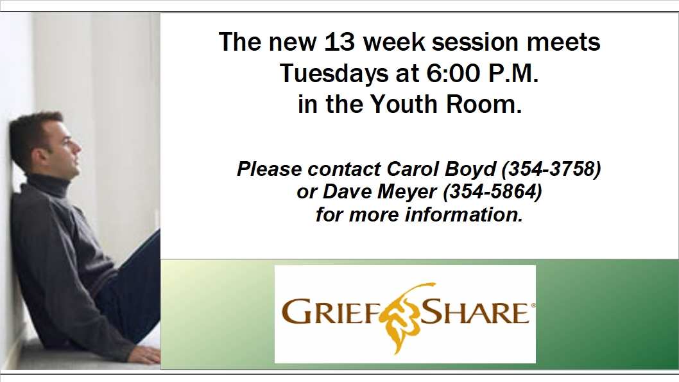
“GRIEF SHARE GROUP”
A
N
N
O
U
N
C
E
M
E
N
T

